Slide 1
Model Predictive Control Local Planner with dynamic Obstacle Avoidance
Presented by Kevin Eppacher
Supervisor: Simon Schweiger, MSc.
17.09.2024

Slide 2
Motivation (less talking)
Applications of mobile Robots:
Mobile Service Robots
Industry Automated Guided Vehicles (AMR)
Military Mobile Robots
(Facts will follow)
Rapid Changing Environments:
Children and Pets
Employees and Objects
(Facts will follow)
Solution: Safe, fast and reactive Mobile Robot Local Planner
Sum it up → shorten

Slide 3
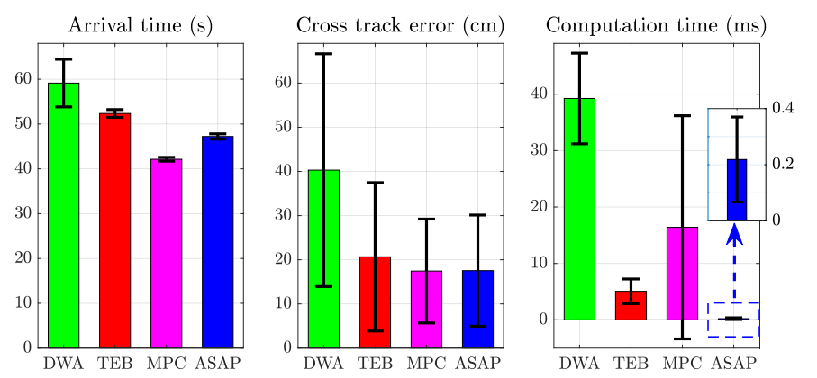
State-of-the-Art (two sentences for nMPC, i wanna improve ist ablka)
Dynamic Window Approach (DWA) Local Planners
Timed-Elastic-Band (TEB) Local Planners
Model Predictive Control (MPC)
Move Base Flex (MBF)
Agile and Safe Pursuit (ASAP)
[1] Lee, Dong-Hyun & Choi, Sunglok & Na, Ki-In. (2024). ASAP: Agile and Safe Pursuit for Local Planning of Autonomous Mobile Robots. IEEE Access. PP. 1-1. 10.1109/ACCESS.2024.3429506.

Slide 4
Scientific Contribution
This work contributes to the state-of-the-art development, of a nonlinear Model Predictive Controller for a mobile robot with integrated dynamic obstacle avoidance. The main objective is to design a local planner that effectively addresses the challenges of dynamic obstacle avoidance. Unlike the seminal work approaches such as Dynamic Window Approach, the proposed nMPC effectively handles nonlinear dynamics and dynamic obstacles, offering superior prediction accuracy and responsiveness.
(Scientific Contribution needs to be corrected)

Slide 5
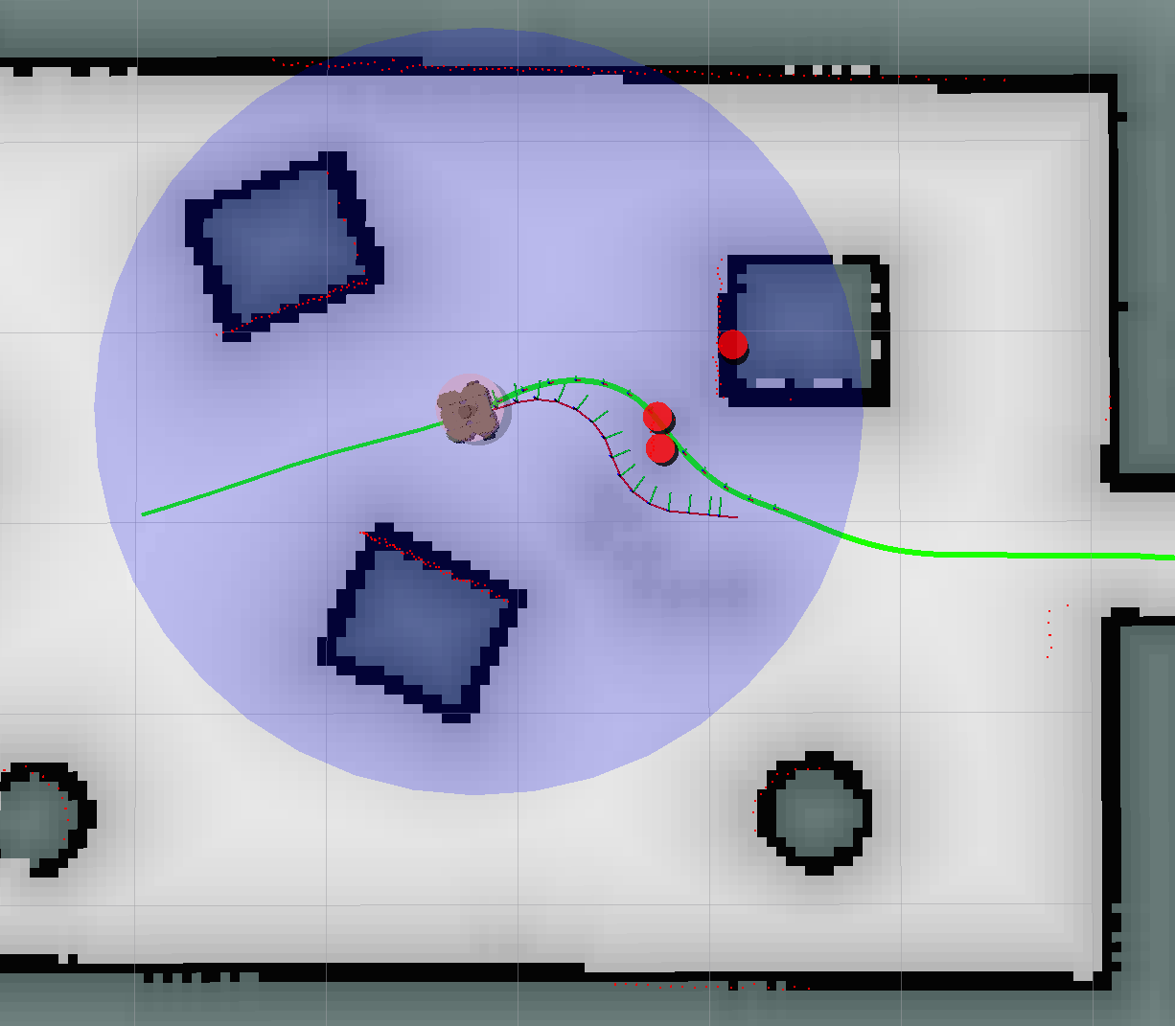
Objective
Generating global plan with ROS MoveBase
Reshaping global plan for nMPC Controller
Detecting obstacles
Tracking trajectory with nMPC Controller with
dynamic model constraint
obstacle avoidance constraints
Text bigger
I m show you my results …
Then how i did it

Slide 6
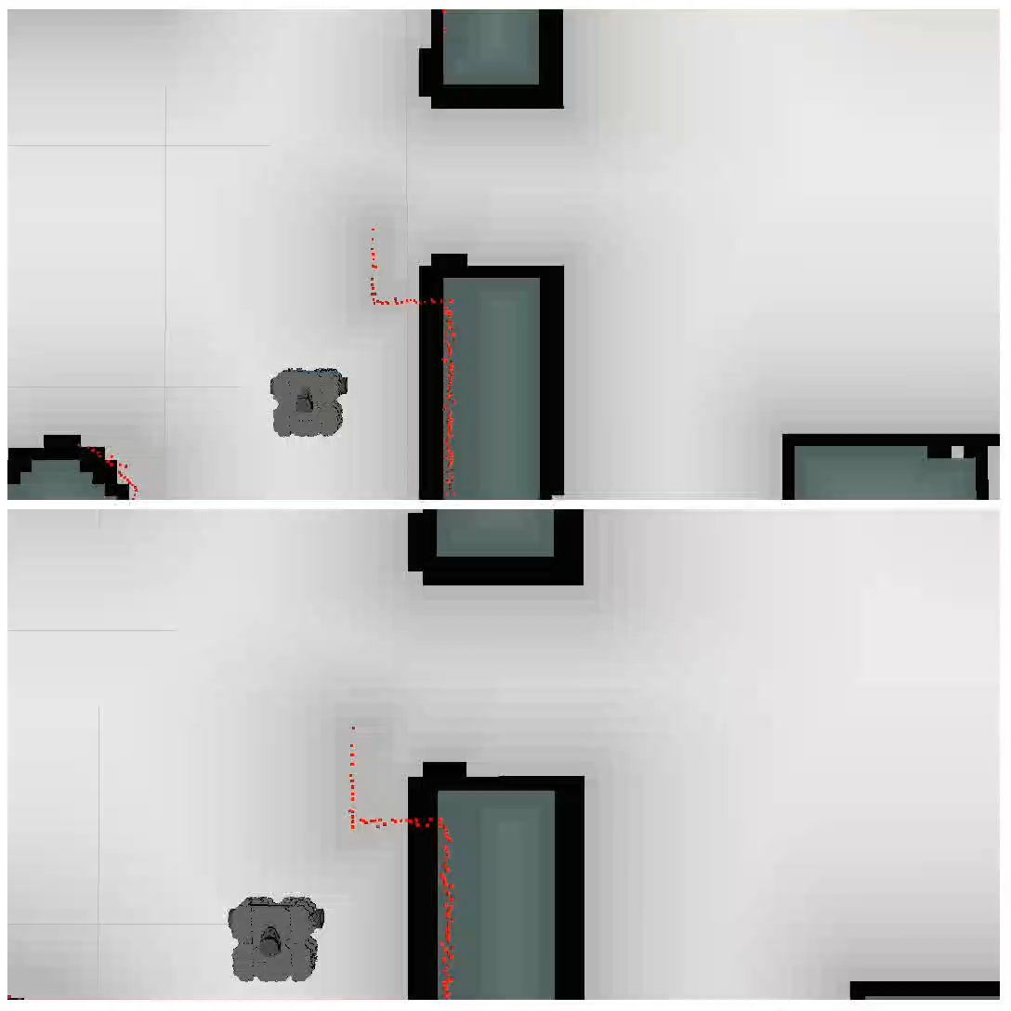
Results
Static obstacle avoidance with narrow door
nMPC Duration: 15.99 s without collision
DWA Duration: 28.19 s with collision

Slide 7
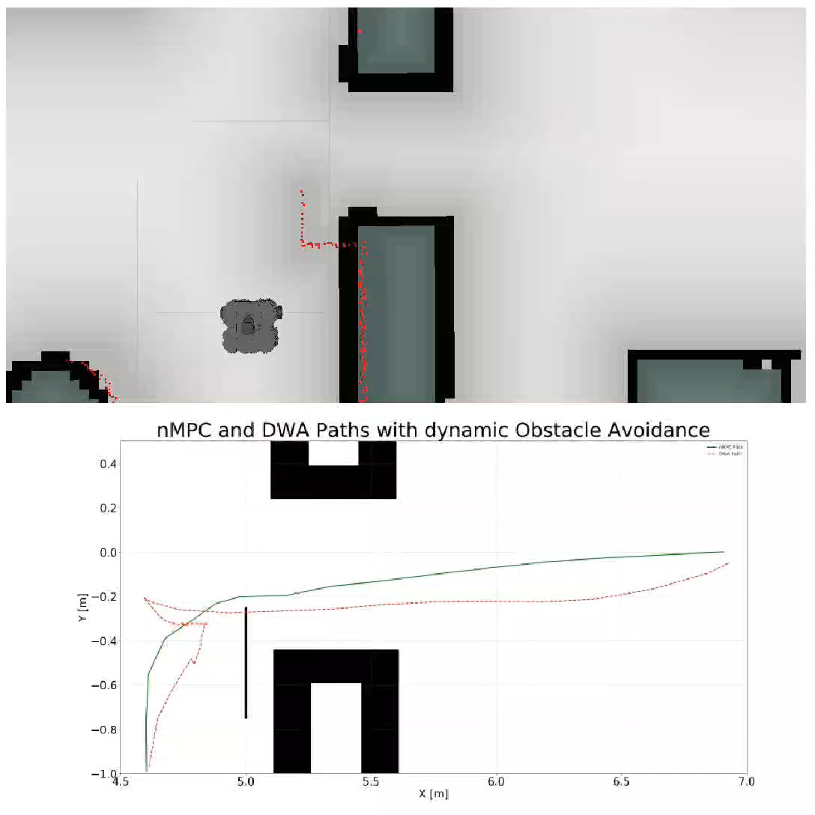
Results
Static obstacle avoidance with narrow door

Slide 8
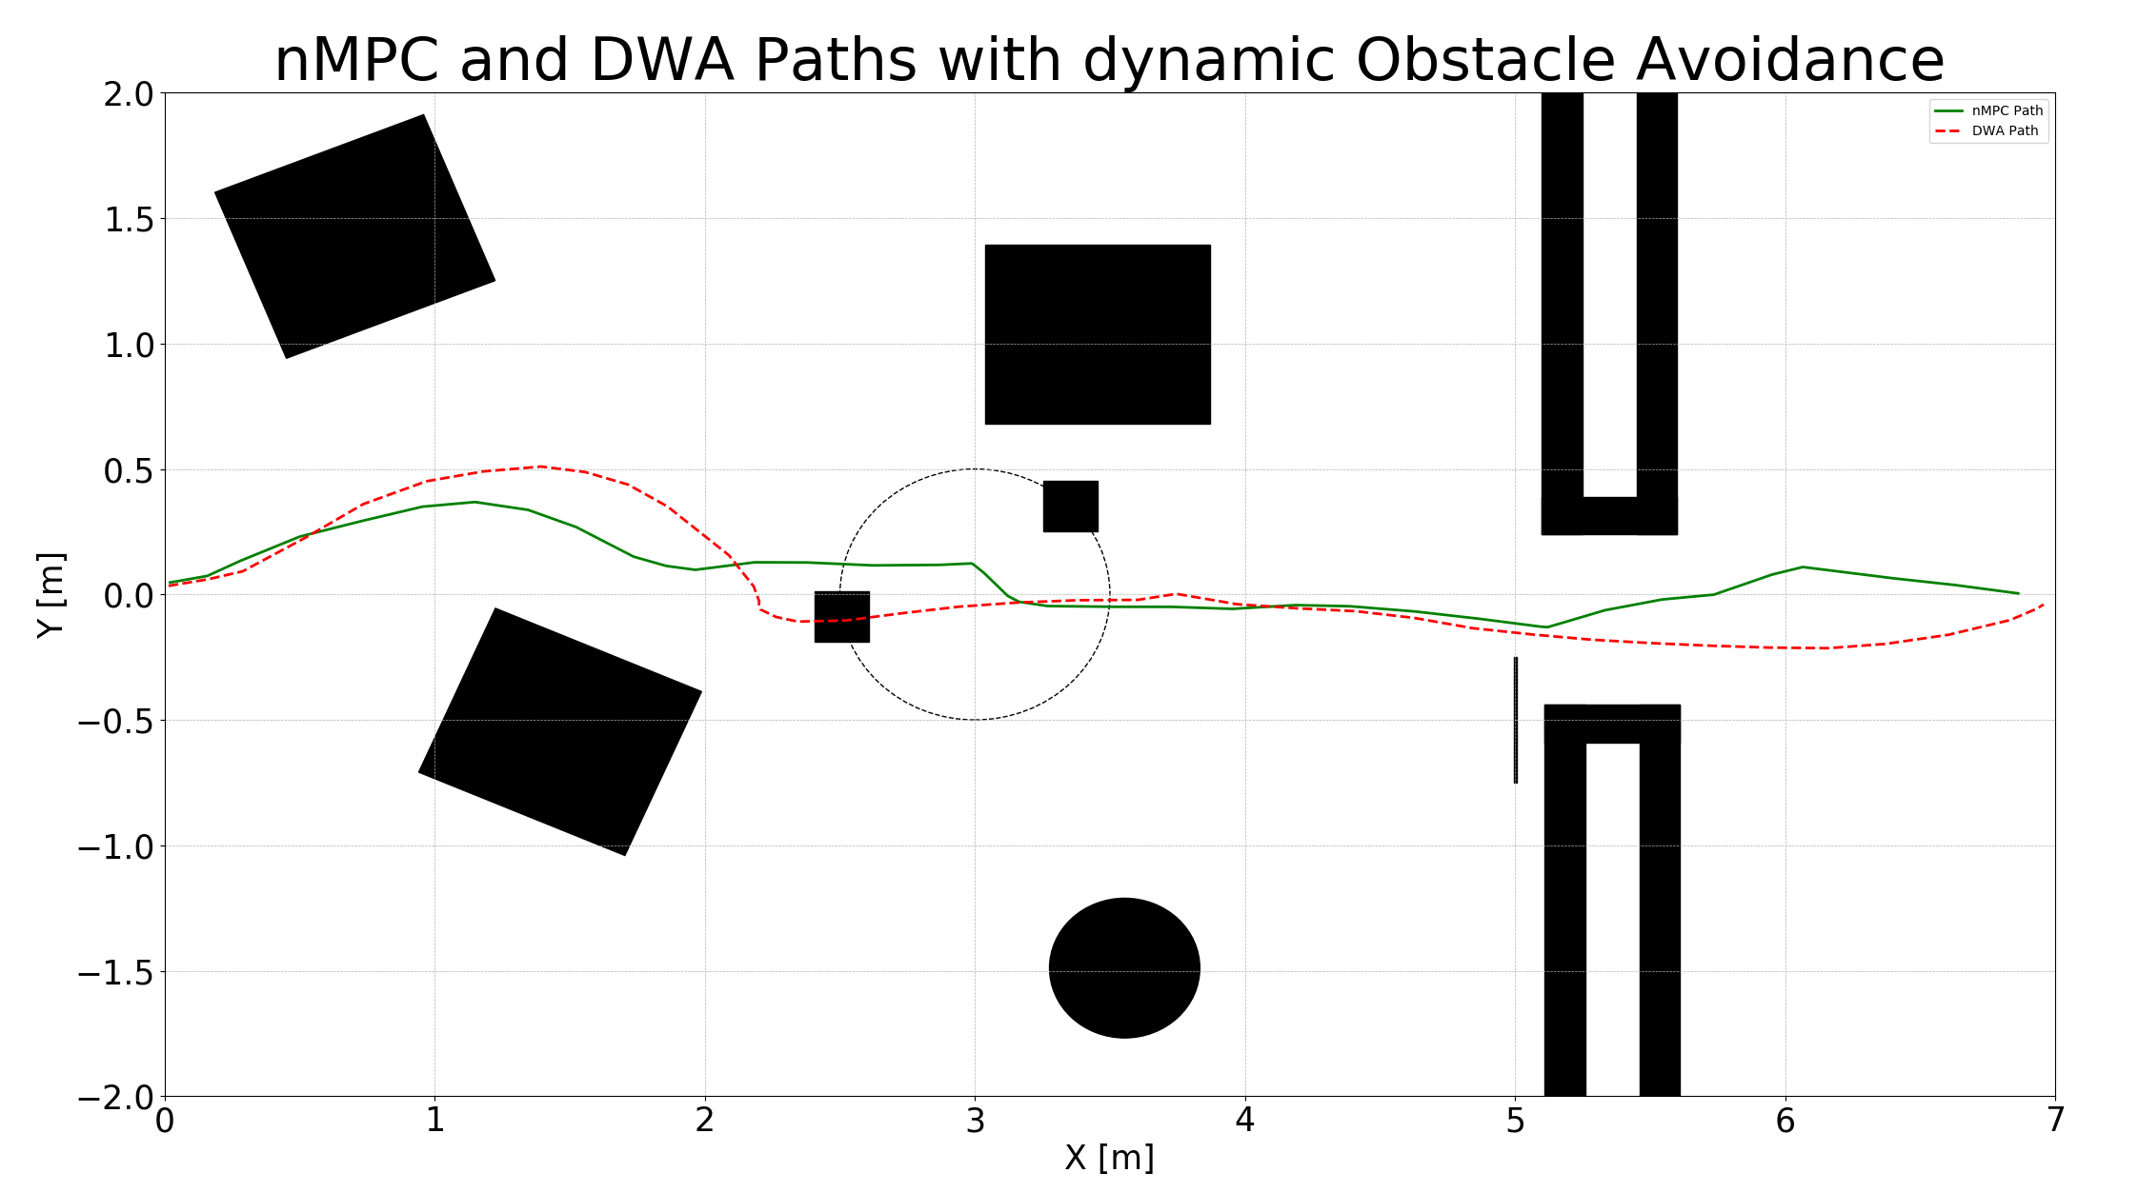
Results
Dynamic obstacle avoidane
Cube moving in a circle

Slide 9
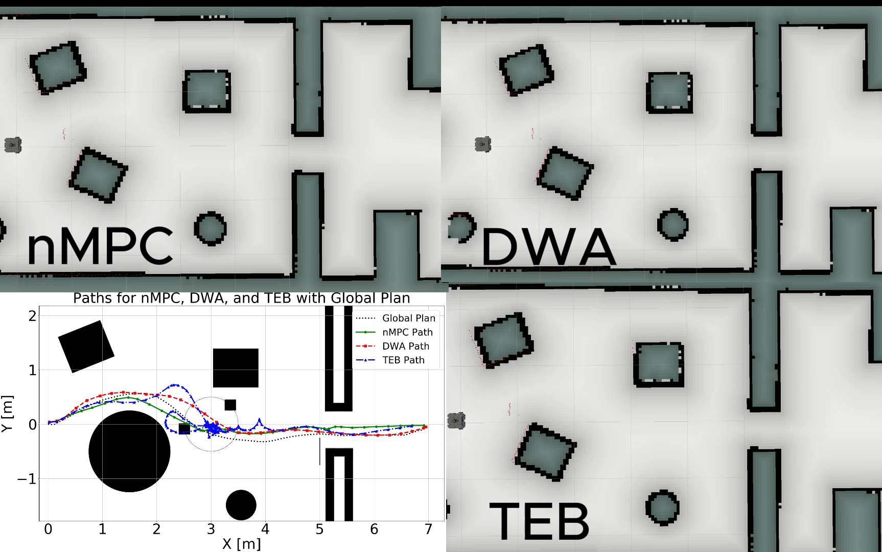
Results: Dynamic obstacle avoidane

Slide 11
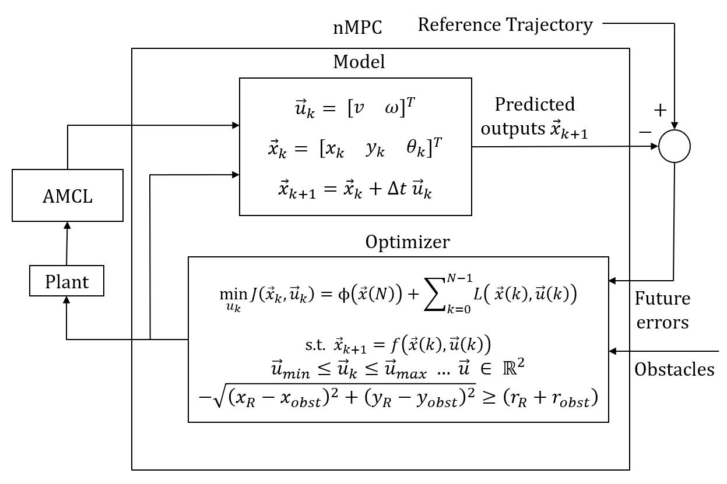
Methodology

Slide 12
Methodology Reference Trajectory
Get global Plan from MoveBase
Adjust orientation from each waypoint
Interpolate waypoints for the same amount of predictions
Calculate the neccessary time constant for controller
Visualization will follow

Slide 13
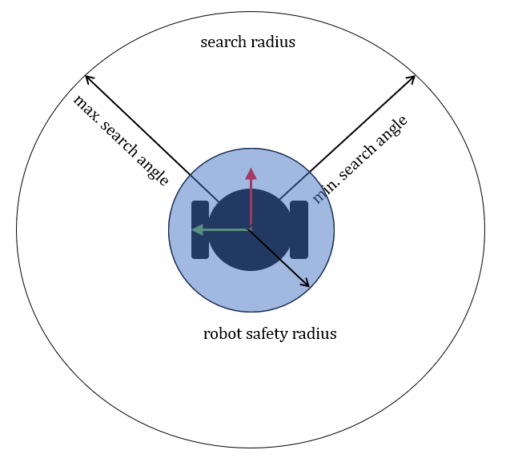
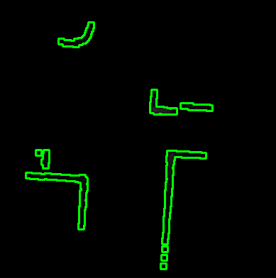
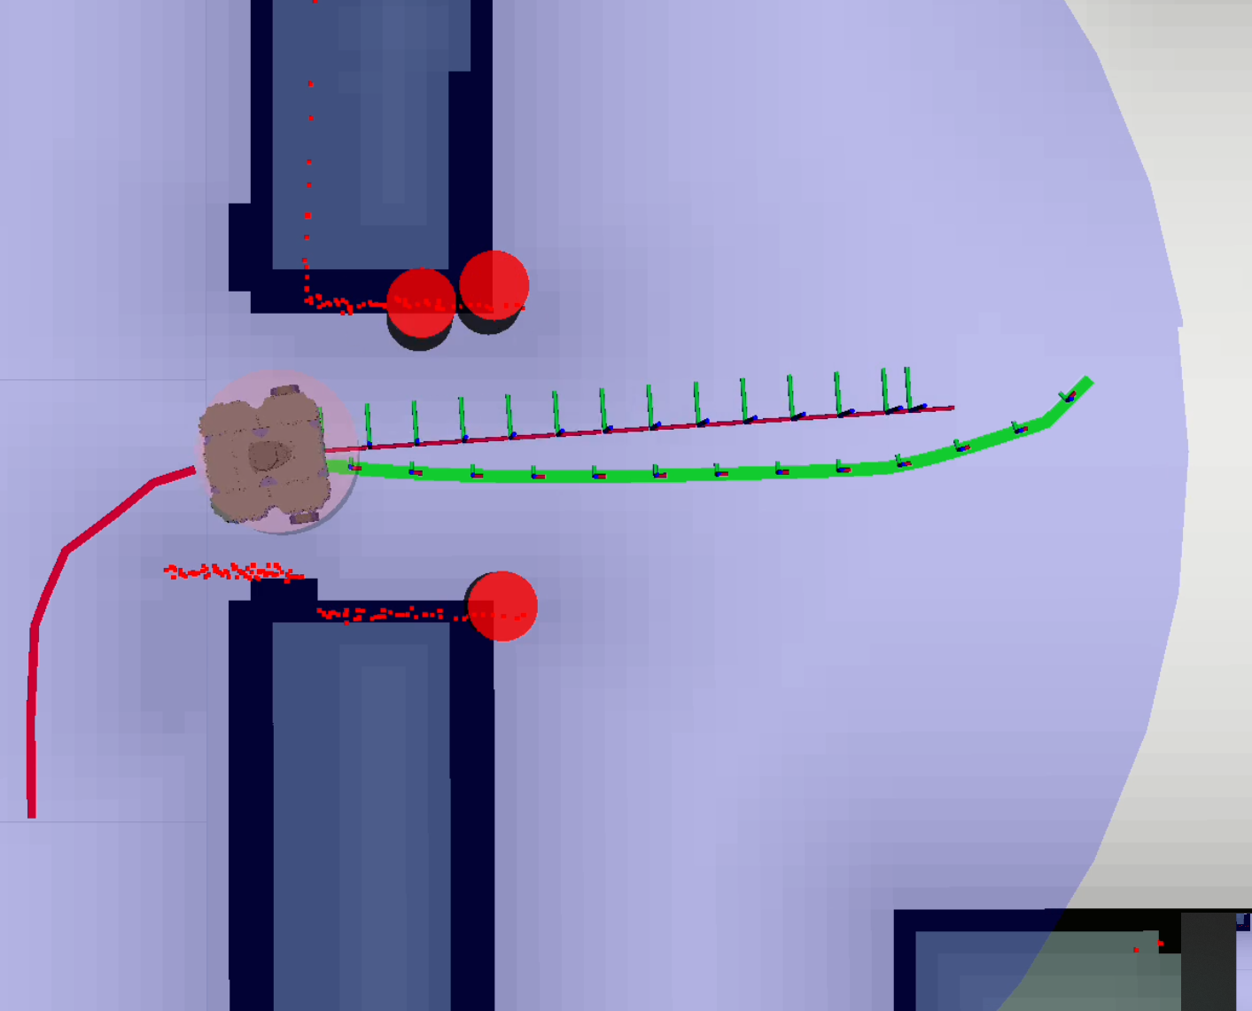
Methodology Object Detection
Define search diameter
Define search angle
Search for cornerns within the search area with Shi-Tomasi Corner Detection Algorithm
Store the corners, which are the nearest in a list
List of obstacles will be sent to the controller

Slide 14
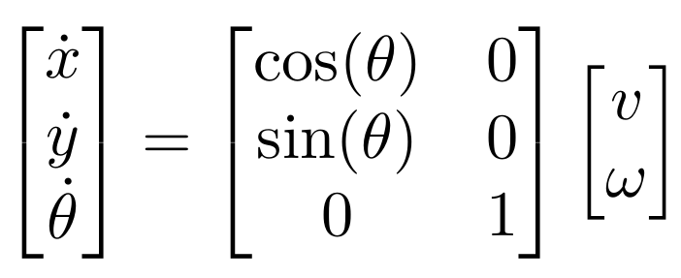
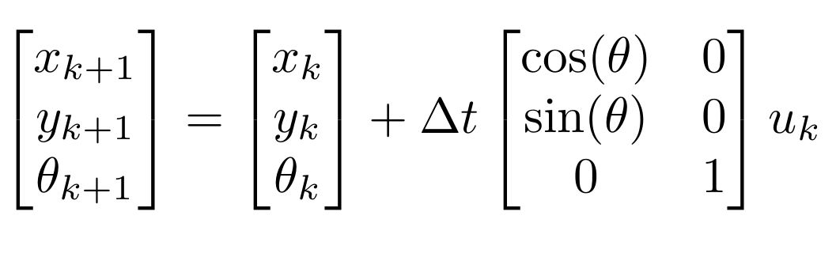
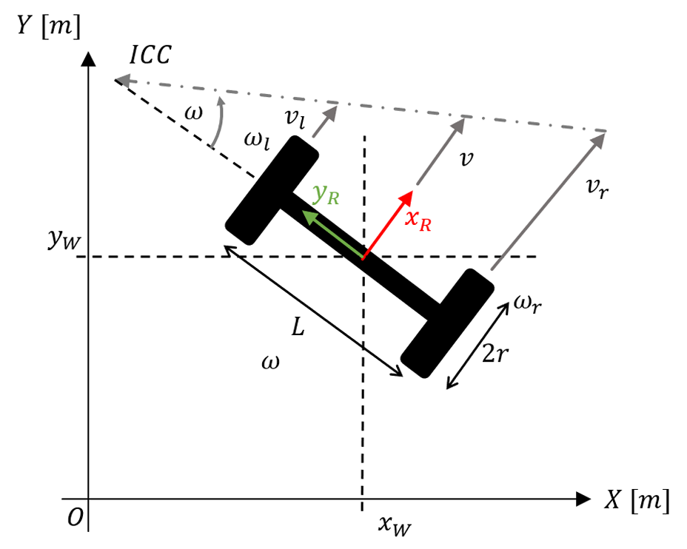
Methodology Model
Kinemantic Model in Cartesian Coordinates
Pros:
Simplicity
Less computationally intensive
Sufficient Accuracy for Many Applications
Easier to Implement
Skid steering model
Cons:
Less accurate prediction

Slide 15
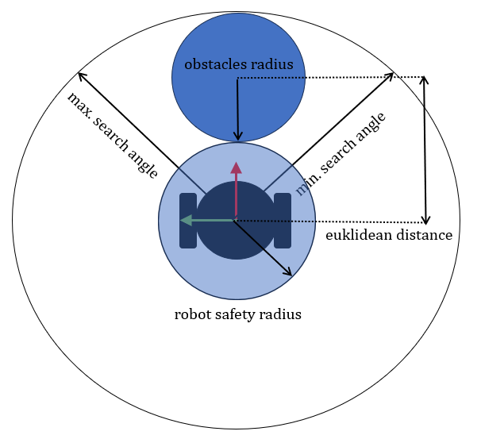
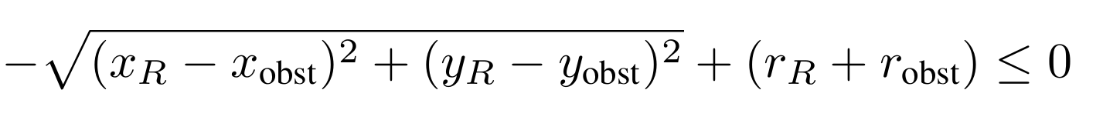
State-of-the-Art: Optimizer
Safety hard constraints:
Limit amount of obstacles → computational intensive

Slide 16
Discussion
Better representation of the obstacles
→ fewer and more descriptive
Not optimal solution, when dealing with obstacles
→ adjusting cost function
→ Better model representation
Still computationally intensive
→ 0.1 – 0.2 s frequency rate

Slide 17
Summary and Outlook
Longer prediction horizon than DWA
nMPC faster than DWA in narrow environment
Predicting the movement of the obstacles
More results will follow
Notes:
Not limited on the frames

Slide 18
Backup

Slide 19
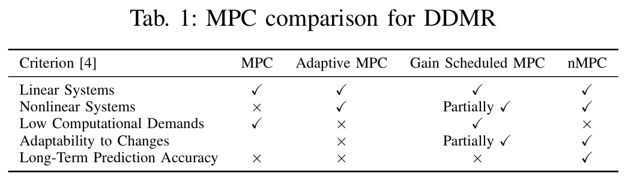
State-of-the-Art: Optimizer

Slide 20
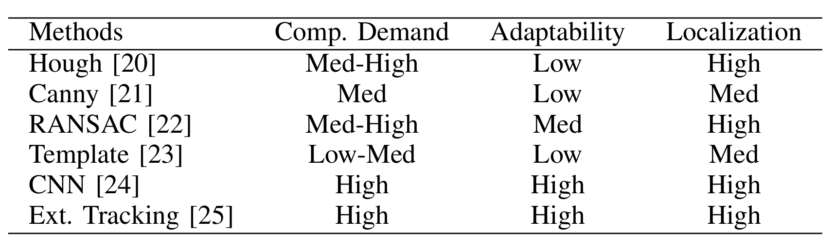
State-of-the-Art: Object Detection
Primary aim for shapes:
circles
rectangles
ellipses

Slide 21
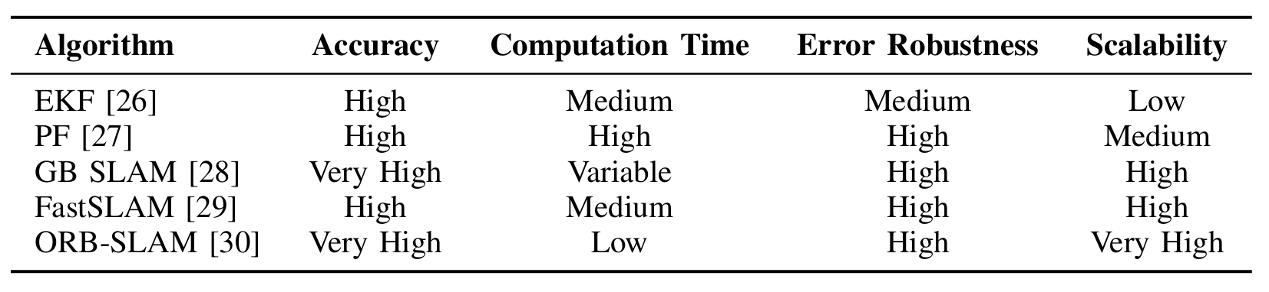
Methodology Sensor Fusion
[26] A. Eman and H. Ramdane, “Mobile robot localization using extended mobile robot in dynamic environment,” 07 2012 in 2020 3rd International Conference on Computer Applications Information Security (ICCAIS), 2020, pp. 1–5.
[27] D. Talwar and S. Jung, “Particle filter-based localization of a mobile nonholonomic mobile robots,” Robotics, IEEE Transactions on, vol. 21, pp. 1022– 1028, 11 2005 robot by using a single lidar sensor under slam in ros environment,” in 2019 19th International Conference on Control, Automation and Systems (ICCAS), 2019, pp. 1112–1115.
[28] W. Benchouche, R. Mellah, and M. S. Bennouna, “Navigation of a differential drive mobile robot using nonlinear model graph-based slam,” IEEE Transactions on Intelligent el
[29] J. Luo and S. Qin, “A fast algorithm of simultaneous localization andTransportation Systems Magazine, vol. 2, pp. 31–43, 12 2010.
mapping for mobile robot based on ball particle filter,” IEEE Access, 9 vol. PP, pp. 1–1, 03 2018.
[30] J. Lin, J. Peng, Z. Hu, X. Xie, and R. Peng, “ORB-SLAM, IMU and Wheel Odometry Fusion for Indoor Mobile Robot Localization and Navigation,” Academic Journal of Computing Information Science, vol. 3, no. 1, pp. 131–141, 2020. [Online]. Available: https://doi.org/10.25236/AJCIS.2020.030114

Slide 22
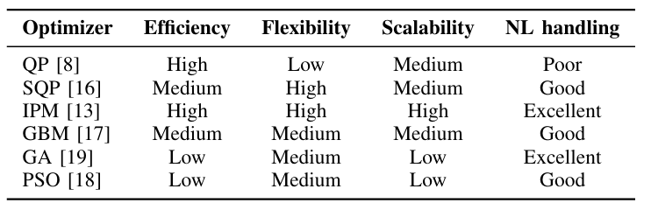
State-of-the-Art: Optimizer
[8] N. Eslami and R. Amiadifard, “Moving target tracking and obstacle avoidance for a mobile robot using mpc,” in 2019 27th Iranian Conference on Electrical Engineering (ICEE), 2019, pp. 1163–1169.
[16] D. Boiroux and J. B. Jørgensen, “Sequential 1 quadratic programming for nonlinear model predictive control,” IFAC-PapersOnLine, vol. 52, no. 1, pp. 474–479, 2019, 12th IFAC Symposium on Dynamics and Control of Process Systems, including Biosystems DYCOPS 2019. [Online]. Available: https://www.sciencedirect.com/science/article/pii/S2405896319301934
[13] W. Benchouche, R. Mellah, and M. S. Bennouna, “Navigation of a differential drive mobile robot using nonlinear model graph-based slam,” IEEE Transactions on Intelligent Transportation Systems Magazine, vol. 2, pp. 31–43, 12 2010. [29] J. Luo and S. Qin, “A fast algorithm of simultaneous localization and predictive control,” L2CSP Laboratory, Faculty of Electrical and Computing Engineering, University Mouloud Mammri of Tizi Ouzou, 15000, Algeria; Mechanical engineering dept, University Kasdi Merbah, Ouargla, 30000, Algeria, 2021.
[17] I. Kempf, P. Goulart, and S. Duncan, “Fast gradient method for model predictive control with input rate and amplitude constraints**this research is supported by the engineering and physical sciences research council (epsrc) with a diamond case studentship.” IFAC-PapersOnLine, vol. 53, no. 2, pp. 6542–6547, 2020, 21st IFAC World Congress. [Online]. Available: https://www.sciencedirect.com/science/article/pii/S2405896320303268
[19] W. Naeem, R. Sutton, J. Chudley, F. Dalgleish, and S. Tetlow, “An online genetic algorithm based model predictive control autopilot design with experimental verification,” International Journal of Control- INT J CONTR, vol. 78, pp. 1076–1090, 09 2005.
[18] Q. Zou, J. Ji, S. Zhang, M. Shi, and Y. Luo, “Model predictive control based on particle swarm optimization of greenhouse cli mate for saving energy consumption,” in 2010 World Automation Congress, 2010, pp. 123–128.

